Slide 1

Problems on Counting 2009

Slide 2
Reference
Data
Youtube
Code

Slide 3
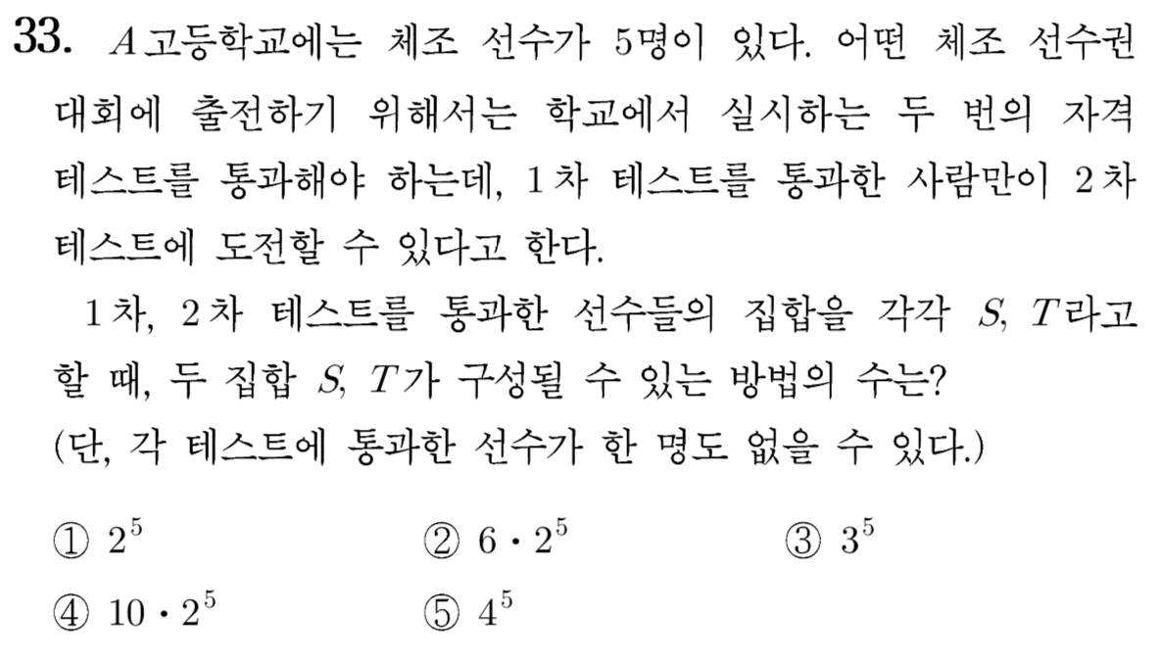
[2009]

Slide 4
